Slide 1
Exploring Positive Digital Practices
Kate Lister
@KateMarburg
@PositiveDigita1

Slide 2
Mental wellbeing in study
Think for a moment about your own study experiences.
Share in the chat:
One word to describe how you felt in your most positive moments
One word to describe how you felt during your most negative experiences
Which experiences were more common? Which still resonate with you?

Slide 4
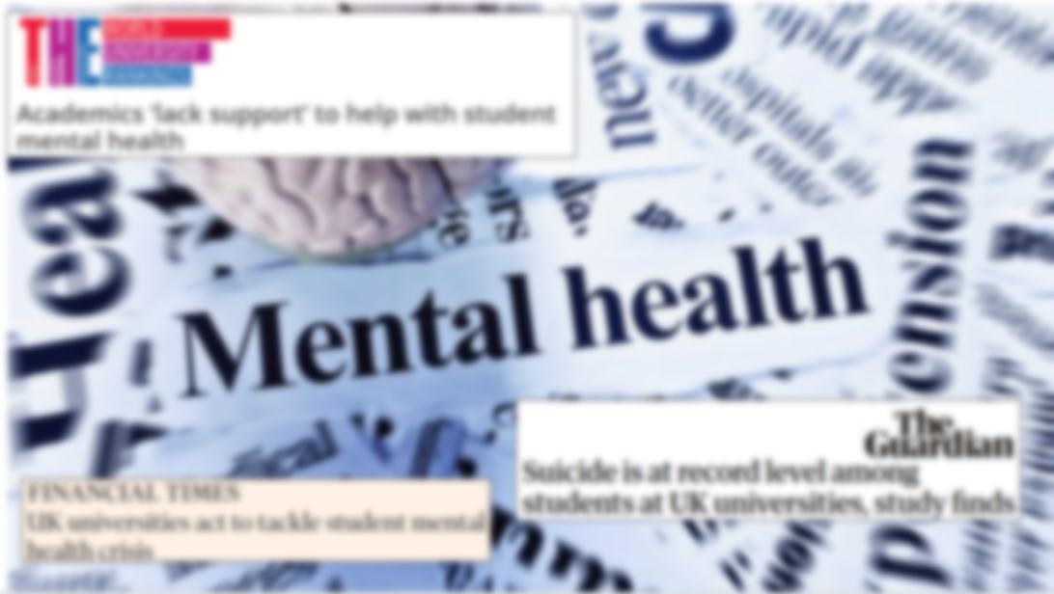
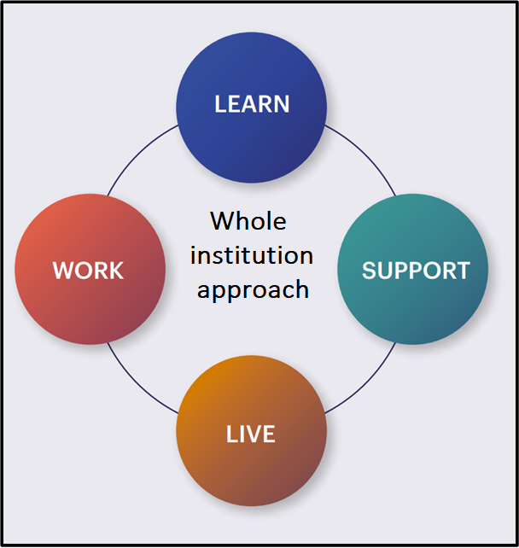

Slide 5
Mental wellbeing in distance learning: barriers, enablers and solutions
Project in the Open University between 2018 and 2021 aimed to apply a social model approach to mental health.
RQ1: What barriers and enablers to mental wellbeing do students experience in distance learning?
RQ2: What solutions do students and staff perceive would reduce these barriers?
RQ3: How can these solutions be embedded in distance learning?

Slide 6
Barriers and enablers to wellbeing in distance learning
Most themes appeared as both barriers and enablers, meaning that a factor can be a barrier or an enabler, depending how it is designed and how the person experiences it.
Lister et al, 2021
https://wellbeinginthecurriculum.weebly.com/

Slide 7
Suggestions for solutions

Slide 8
Reflection
Think for a moment about relating these findings to your study experiences.
Share in the chat or on mic:
Do the barriers and enablers resonate with you?
What is your first impression of the solution ideas and projects?

Slide 9
A two-year £350k collaborative project, funded by Office for Students, focusing on part-time, distance and commuter students. Partners are:
Open University
University of Bradford
University of Warwick
Jisc
Student Minds
UMHAN
Positive Digital Practices

Slide 10
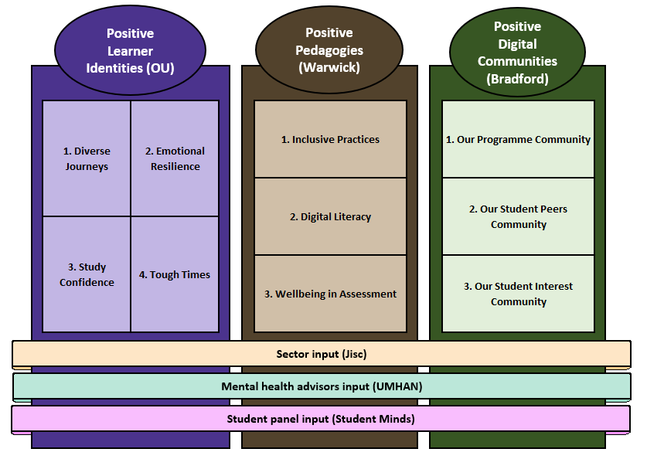
Positive Digital Practices year 1

Slide 11
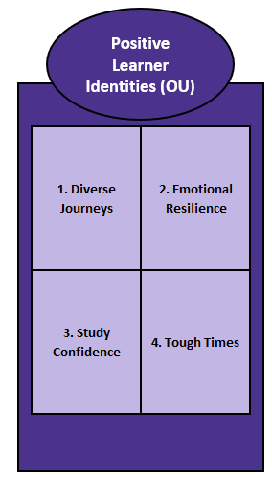
Positive Learner identities
Diverse Journeys (Tim Coughlan and Kate Lister)
Aim: to create guidance for tutors, MH practitioners and students on Our Journey, a digital tool designed to support students to share and reflect on challenges and achievements in their study journey.
Outputs:
Guidance for students suggesting approaches to telling their stories (mindful, retrospective or skills focused) and reflecting on their journeys (lenses of self-compassion, growth mindset or values)
Guidance for staff on supporting students to tell their stories and reflect on their journeys
A set of vignettes depicting ‘Diverse Academic Journeys’, different experiences in academia (4 completed, 3 in progress)

Slide 12
Positive Learner identities
Emotional resilience (Julia Downes)
Aim: to develop practical resources to support students to study potentially distressing content and offer opportunities for students to understand and draw on lived experiences in a positive way.
Outputs:
A student/tutor podcast in four parts (impacts, benefits, strategies, duty of care)
A series of videos (four finalised) from students, ALs and lecturers on their experiences of distressing content and tips for developing emotional resilience
Written guidance for students on studying potentially distressing content and developing emotional resilience

Slide 13
Positive Learner identities
Study confidence (Agnes Kukulska-Hulme and Kate Lister)
Aim: to develop discipline-specific guidance and resources to develop confidence and wellbeing in technology-enhanced learning and overcome discipline-specific challenges such as maths anxiety, fear of group-work, and distress relating to academic writing and giving presentations.
Outputs: Student guidance on:
Feeling good about academic writing
Feeling confident in groupwork
Performance anxiety, presentations and public speaking (in progress)
Managing maths anxiety (in progress)

Slide 14
Positive Learner identities
Tough times (Philippa Waterhouse):
Aim: To create resources to help students navigate difficult circumstances that impact on their study, such as clashes with home life commitments, stressful study periods and relationships breaking down.
Outputs:
An OpenLearn interactive, co-created with students, on managing tough times at university (currently in production)
‘Speaking after the Split’ – stories of relationship breakups at university (in progress)

Slide 15
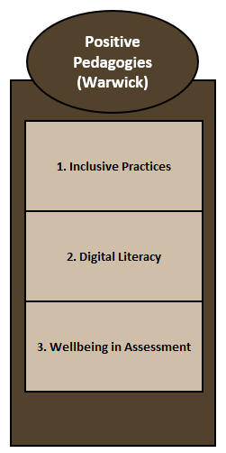
Positive Pedagogies
Warwick: Elena Riva and Sharron Wilson
Inclusive Practices, promoting wellbeing in pedagogic practice, with guidance co-created with mature students with tips to generate cohesion
Digital Literacy, co-creating digital resources and activities to support development of digital literacy, build skills and confidence, and support wellbeing.
Wellbeing in Assessment, improving students’ wellbeing through assessment pedagogies, guidelines and feedback methods.

Slide 16
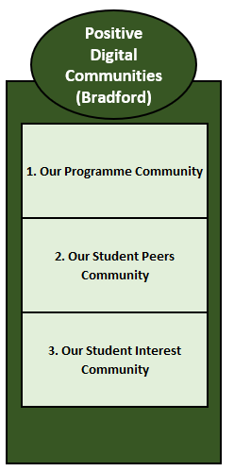
Positive Digital Communities
Bradford: Alison Hartley and Sophie Jones-Tinsley
Our Programme Community, supporting university staff to embed positive digital communities with their students in the context of a programme of study.
Our Student Peers Community, supporting student representatives to create positive digital peer communities that are related to programmes of study.
Our Student Interest Community, supporting students to embed positive digital communities within student-led activity groups

Slide 17
Stakeholder engagement
Jisc leads on sector-wide engagement, drawing on their established cross-disciplinary networks in technology-enhanced learning
UMHAN leads on engagement of mental health professionals, bringing expertise from 400 mental health advisors and mentors from 130 institutions
Student Minds leads on student engagement in the project, facilitating a student panel to steer and guide the project

Slide 18
Year 1
Draft outputs from work packages by 30 June 2022
Showcasing and evaluation meeting 14 July 2022

Slide 19
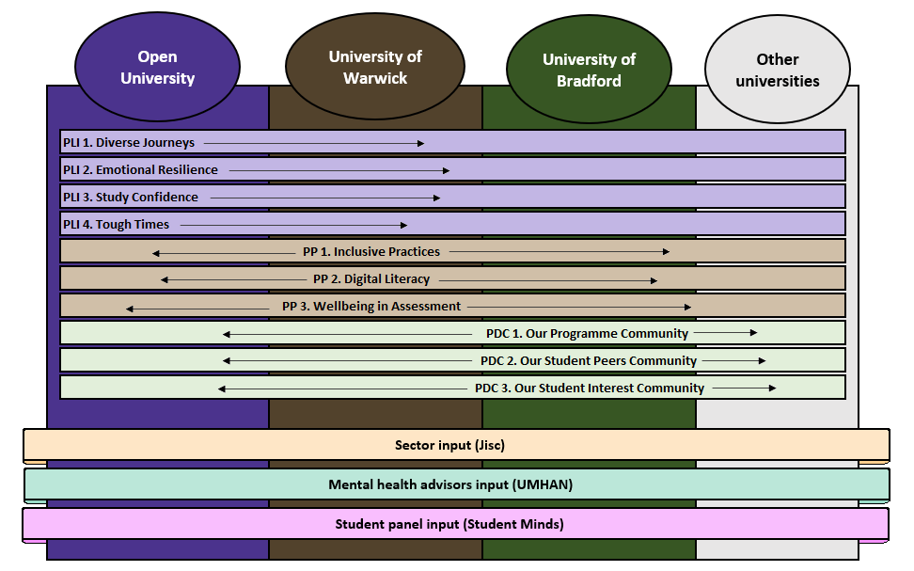
Year 2
Seeking partners!
Project evaluation June/July 2023

Slide 20
Synergies and connections
We’re keen to seek your insights and explore possibilities for collaboration!
Did you identify any areas of interest, synergies with current work or connections?
Do you have any questions, comments or suggestions?

Slide 21
Mental wellbeing in study
Think back to the word association exercise, and the words you chose. Share in the chat:
One word you would like your students to describe how they felt in their most positive moments
One word or phrase you would like your students to describe how they felt in their most negative experiences
What positive digital practices might help us to get there?

Slide 22
Thank you!

